Slide 1
Activation Functions
By Aymen Tariq

Slide 2
Topics to cover:
Sigmoid
TanH
ReLu
Swish

Slide 3
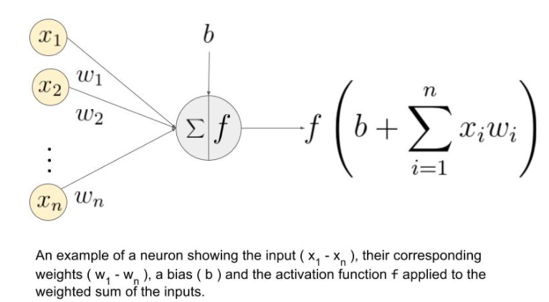
Activation Functions in Perceptrons
Used to decide whether a neuron should be activated or not
done by calculating the weighted sum and providing it to the activation function
Activation function maps the resulting values in between a specific range e.g. 0-1, etc.

Slide 4
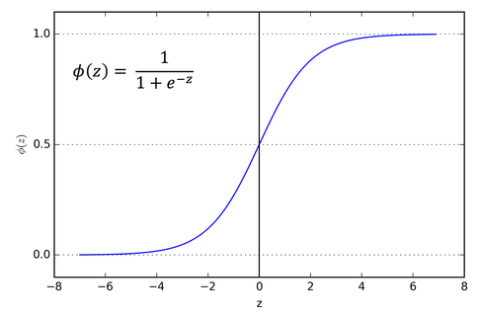
Sigmoid Activation Function
This function is used in output layer of a neural network
for probability-based outputs
ranges between 0 to 1

Slide 5
Problem with Sigmoid
Vanishing gradient problem
Arises when we have to convert large input into the range 0-1
Derivative becomes so small that it doesn’t provide suitable output.

Slide 6
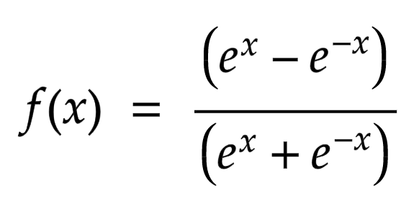
Tan Hyperbolic Activation Function
Similar to sigmoid function
Range between. -1 to 1
If the input is larger, the output will be closer to 1
With smaller input, the output will be closer to -1

Slide 7
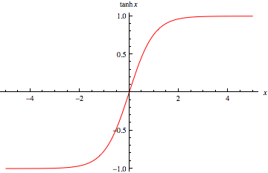
Tan Hyperbolic Activation Function
This function is zero-centered
We can map the input values as strongly negative, neutral, and strongly positive
It is used when the output is other than 0 and 1

Slide 8
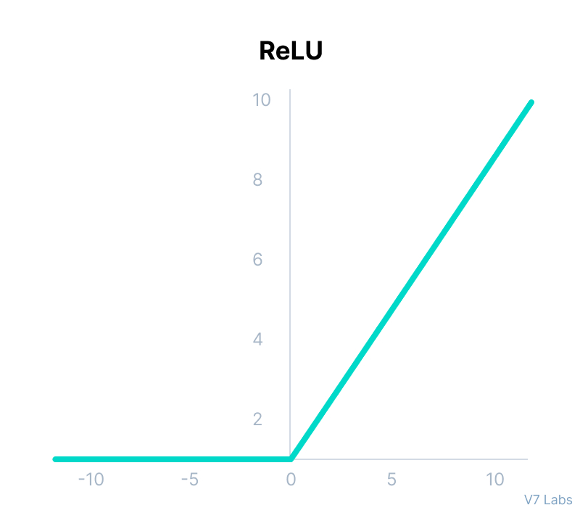
Rectified Linear Unit (ReLu)
Simple and efficient activation function
It doesn’t calculate exponentials and divisions
Makes use of derivatives for faster computation
f(x)=x if x≥0 and 0 if x<0

Slide 9
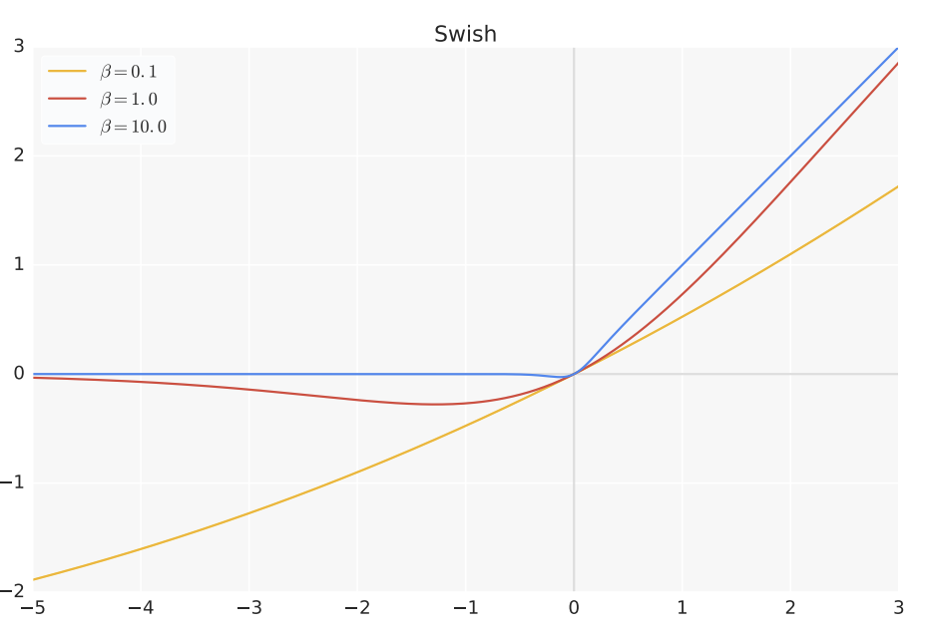
Swish Activation Function
f(x)=x ∗ sigmoid(βx), where β is a trainable parameter
Beneficial for non-monotonic functions
Allows a small number of negative weights to be propagated through
trainable parameter allows to better tune the activation function to maximize information propagation

